Slide 1
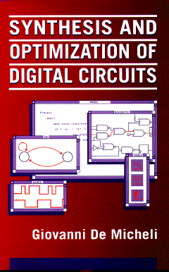


Multi-level Logic Synthesis
Giovanni De Micheli
Integrated Systems Centre
EPF Lausanne
This presentation can be used for non-commercial purposes as long as this note and the copyright footers are not removed
© Giovanni De Micheli – All rights reserved

Slide 2
Module 1
Objectives
  What is multi-level logic synthesis
  What are the specific goals
  Stepwise transformations

Slide 3
Motivation
Multiple-level logic networks
  Semi-custom libraries
  Logic gates versus macro-cells
    More flexibility
    Privilege specific paths on others
    Better performance
Applicable to a large variety of designs
The importance of logic synthesis grew in parallel with the growth of foundries for the semi custom market

Slide 4
Circuit model
Logic network
  An interconnection of blocks
    Each block modeled by a Boolean function
  Usual restrictions:
    Acyclic and memoryless
    Single-output functions
The model has a structural/behavioral semantics
  The structure is induced by the interconnection
Mapped network
  Special case when the blocks correspond to library elements

Slide 5
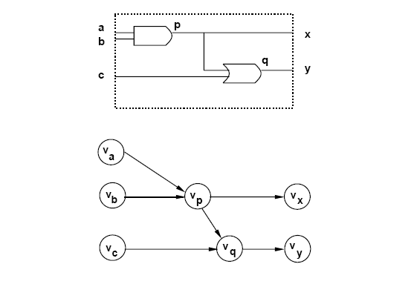
Example of mapped network

Slide 6
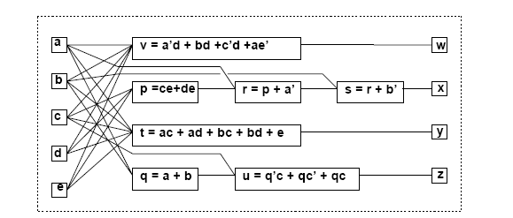
Example of general network

Slide 7
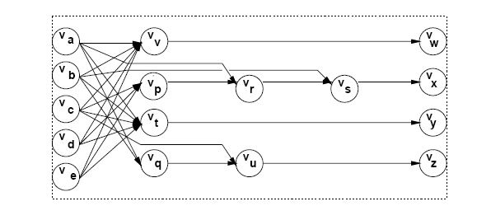
Example of general network graph

Slide 8
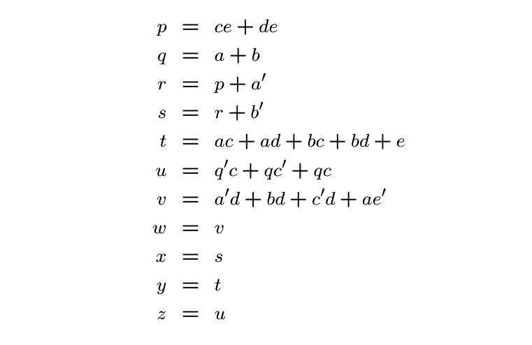
Network represented by assignments

Slide 9
Example of terminal behavior
I/O functional behavior
  Vector with as many entries as primary outputs
  Each entry is a logic function
  a’d + bd + c’d + ae’
  a’ + b’ + c + d
  ac + ad + bc + bd + e
  a + b + c
f =

Slide 10
Network optimization
Minimize maximum delay
  (Subject to area or power constraints)
Minimize area
  Subject to delay constraints
Minimize power consumption
  Subject to timing constraints

Slide 11
Estimation
Area:
  Number of literals
    Easy, widely accepted, good estimator
Delay:
  Number of stages
  Gate delay models with wireloads
  Sensitizable paths
Power
  Switching activity at each node
  Capacitive loads

Slide 12
Problem analysis
Even the simplest problems are computationally hard
  E.g., multi-input single-output network
Few exact methods proposed
  High complexity
  Impractical
Approximate optimization methods
  Heuristic algorithms
  Rule-based methods

Slide 13
Strategies for optimization
Improve network step by step
  Circuit transformations
Preserve network I/O behavior
  Exploit environment don’t cares if desired
Methods differ in:
  Types of transformations applied
  Selection and order of the transformations

Slide 14
Elimination
Eliminate one function from the network
  Similar to Gaussian elimination
Perform variable substitution
Example:
  s = r + b’; r = p + a’;
  s = p + a’ + b’;

Slide 15
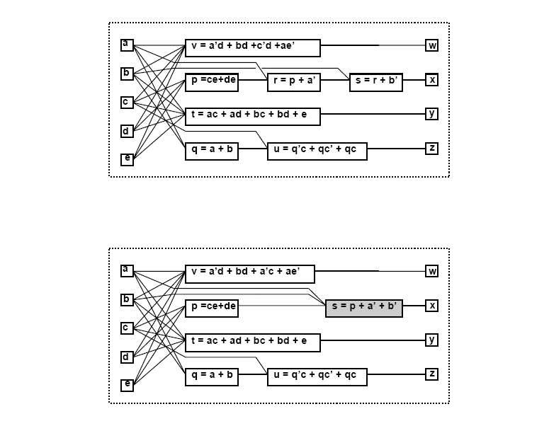
Example

Slide 16
Decomposition
Break a function into smaller ones
  Opposite to elimination
Introduce new variables/blocks into the network
Example:
  v = a’d + bd +c’d +ae’
  j = a’ + b + c’; v = jd + ae’;

Slide 17
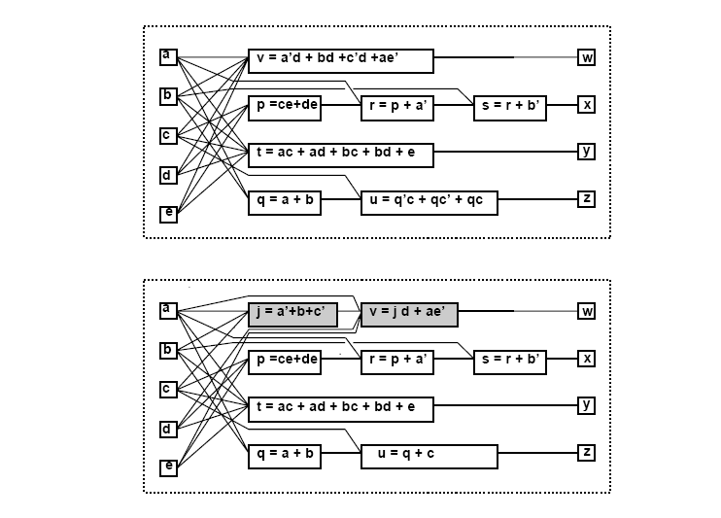
Example

Slide 18
Extraction
Find a common sub-expression of two (or more) expressions
  Extract new sub-expression as new function
  Introduce new block into the circuit
Example
  p = ce + de; t = ac + ad + bc + bd + e;
  p = ( c + d ) e; t = ( c + d ) ( a + b ) + e;
  k = c + d; p = ke; t = ka + kb + e;

Slide 19
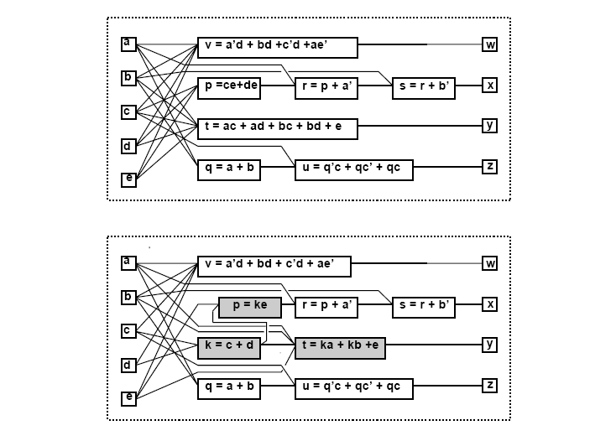
Example

Slide 20
Simplification
Simplify local function
  Use heuristic minimizer like Espresso
  Modify fanin of target node
Example:
  u = q’ + qc’ + qc;
  u = q + c;

Slide 21
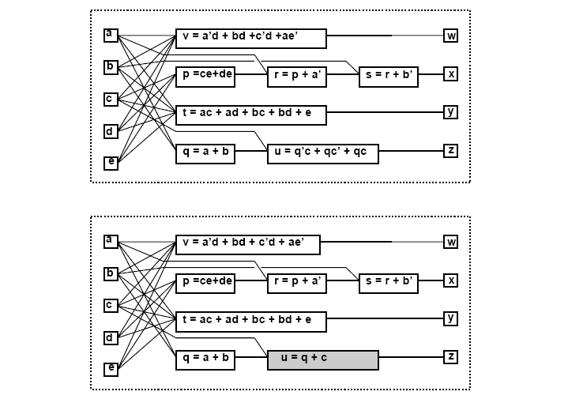
Example

Slide 22
Substitution
Simplify a local function by using and additional input
that was not previously in its support set
Example:
  t = ka + kb + e;
  t = kq + e;
  Because q = a + b is already part of the network

Slide 23
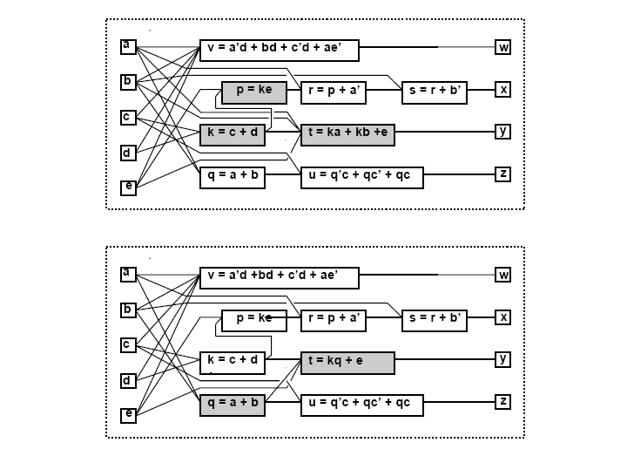
Example

Slide 24
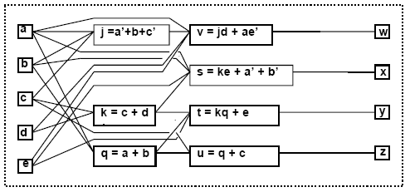
Example – Sequence of transformations
  j = a’ + b + c
  k = c + d
  q = a + b
  s = ke + a’ + b’
  t = kq + e
  u = q + c
  v = jd + ae’

Slide 25
Optimization approaches
Algorithmic approach
  Define an algorithm for each transformation type
  Algorithm is an operator on the network
  Algorithms are sequenced by scripts
Rule-based approach
  Rule data base
    Set of pattern pairs
  Pattern replacement is driven by rules
Most modern tools use the algorithmic approach to synthesis, even though rules are used to address specific issues

Slide 26
Boolean and algebraic methods
Boolean methods for multilevel synthesis
  Exploit properties of Boolean functions
  Use don’t care conditions
  Computationally intensive
Algebraic methods
  Use polynomial abstraction of logic function
  Simpler, faster, weaker
  Widely used

Slide 27
Example
Boolean substitution:
  h = a + bcd + c; q = a + cd;
  h = a + bq + e;
  Because a + bq +e = a + b(a+cd) + e = a + bcd + e;
Algebraic substitution:
  t = ka + kb + e;
  t = kq + e;
  Because q = a + b;

Slide 28
Module 2
Objective
  Algebraic model
  Algebraic division
  Kernel theory and applications

Slide 29
Algebraic model
Boolean algebra
  Complement
  Symmetric distribution laws
  Don’t care sets
Algebraic models
  Look at Boolean expressions as polynomials
  Use sum of product forms
    Minimal w.r.to 1-cube containment
  Use polynomial algebra

Slide 30
Algebraic division
Given two algebraic expressions
  An expression divides algebraically the other
  f_{quotient} = f_{dividend} / f_{divisor} when:
  f_{dividend} = f_{divisor} f_{quotient} + f_{remainder}
  f_{divisor} f_{quotient} ≠ 0
  The support of f_{divisor} and f_{quotient} is disjoint
Note that the f_{quotient} and f_{divisor} are interchangeable

Slide 31
Example
Algebraic division
  f_{dividend} = ac + ad + bc + bd + e
  f_{divisor} = a + b
  Then f_{quotient} = c + d and f_{remainder} = e
  because (a+b) (c+d) + e = f_{dividend}
  and {a,b} ∩ {c,d} = Ø
Non-algebraic division:
  f_{i} = a + bc and f_{j} = a+b
  Then (a+b) (a+c) = f_{i}
  but {a,b} ∩{a,c} ≠ Ø

Slide 32
An algorithm for division
Division can be performed in different way
  Straightforward algorithm by literal sorting
    Simple, quadratic complexity
  Advanced algorithm using sorting
    N-logN complexity
  Typically algebraic division runs fast – small-sized problems
Definitions
  A = set of cubes C^{A}_{j} of the dividend. There are l
  B = set of cubes C^{B}_{i} of the divisor. There are n
  Q = quotient; R = remainder

Slide 33
An algorithm for division
ALGEBRAIC_DIVISION(A,B)
{
for (i = 1 to n)
{
D = {C^{A}_{j} such that C^{A}_{j} ⊇ C^{B}_{i} };
if (D == Ø) return(Ø,A);
D_{i} = D with variables in sup(C^{B}_{i}) dropped;
if i = 1
Q = D_{i} ;
else
Q = Q ∩ D_{i} ;
}
R = A – Q x B;
return(Q,R);
}

Slide 34
Example f_{dividend} = ac+ad+bc+bd+e; f_{divisor} = a+b
A = {ac,ad,bc,bd,e} and B = {a,b}
i = 1:
  C^{B}₁ = a, D = {ac,ad} and D₁ = {c,d}
  Then Q = {c,d}
i = 2 = n:
  C^{B}₂ = b, D = {bc,bd} and D₂ = {c,d}
  Then Q = {c,d} ∩ {c,d} = {c,d}
Result:
  Q = {c,d} and R = {e}
  f_{quotient} = c + d and f_{remainder} = e

Slide 35
Theorem
Given algebraic expression f_{i} and f_{j}
then f_{i} / f_{j} is empty when either:
  f_{j} contains a variable not in f_{i}
  f_{j} contains a cube whose support is not contained in that of any cube of f_{i}
  f_{j} contains more terms than f_{i}
  The count of any variable in f_{j} is higher than in f_{i}

Slide 36
Algebraic substitution
Consider expression pairs
Apply division (in any order)
If quotient is not void:
  Evaluate area and delay gain
  Substitute f_{dividend} by j f_{quotient} + f_{remainder}
  where j is the variable corresponding to f_{divisor}
Use filters based on previous theorem to reduce computation

Slide 37
Substitution algorithm
SUBSTITUTE(Gn(V,E)){
for (i = 1,2,…,|V|){
for (j = 1,2,…,|V|;j ≠ i){
A = set of cubes of f_{i};
B = set of cubes of f_{j};
if (A,B pass the filter test){
(Q,R) = ALGEBRAIC_DIVISION(A,B);
if (Q ≠ Ø){
f_{quotient} = sum of cubes of Q;
f_{remainder} = sum of cubes of R;
if (substitution is favorable)
f_{i} = j f_{quotient} + f_{remainder};
}
}
}
}
}

Slide 38
Extraction
Search for common sub-expressions
  Single-cube extraction
  Multiple-cube extraction (kernel extraction)
Search for appropriate divisors
Extraction is still done using the original kernel theory of Brayton and others [IBM]

Slide 39
Definitions
Cube-free expression
  Expression that cannot be factored by a cube
  Example:
    a + bc is cube free
    abc and ab + ac are not
Kernel of an expression
  Cube-free quotient of the expression divided by a cube, called co-kernel
  Note that since divisors and quotients are interchangeable, kernels are just a subset of divisors
Kernel set of an expression f is denoted by K(f)

Slide 40
Example
f = ace + bce + de + g
Trivial kernel search:
  Divide f by a. Get ce. Not cube free
  Divide f by b. Get ce. Not cube free
  Divide f by c. Get ae + be. Not cube free
  Divide f by ce. Get a + b. Cube free. KERNEL!
  Divide f by d. Get e. Not cube free
  Divide f by e. Get ac + bc + d. Cube free. KERNEL!
  Divide f by g. Get 1. Not cube free
  Divide f by 1. Get f. Cube free. KERNEL!
K(f) ={ (a+b); (ac+bc+d); (ace+bce+de+g) }
CoK(f) = { ce, e, 1}

Slide 41
Theorem
Brayton and McMullen
Two expressions f_{a} and f_{b} have a common multiple-cube divisor f_{d} if and only if
  There exist kernels k_{a} in K(f_{a}) and k_{b} in K(f_{b}) such that
  f_{d} is the sum of two (or more) cubes in k_{a} ∩ k_{b}
Consequences
  If kernel intersection is void, then the search for common sub-expression can be dropped
  If an expression has no kernels, it can be dropped from consideration
  The kernel intersection is the basis for constructing the expression to extract

Slide 42
Example
f_{x} = ace + bce + de + g
f_{y} = ad + bd + cde + ge
f_{z} = abc
K(f_{x}) = { (a+b); (ac+bc+d); (ace+bce+de+g) }
K(f_{y}) = { (a+b+ce); (cd+g); (ad+bd+cde+ge) }
The kernel set of f_{z} is empty
Select intersection (a+b)
  f_{w} = a + b
  f_{x}= wce + de + g
  f_{y} = wd + cde + ge
  f_{z} = abc

Slide 43
Kernel set computation
Naïve method
  Divide function by the elements of the power set of its support set
  Weed out non cube-free quotients
Smart way
  Use recursion
    Kernels of kernels are kernels
  Exploit commutativity of multiplication

Slide 44
Recursive algorithm
The recursive algorithm is the first one proposed for kernel computation and still outperforms others
It will be explained in two steps
  R_KERNELS (with no pointer) to understand the concept
  KERNELS (Complete algorithm)
The algorithms use a subroutine
  CUBES( f,C ) which returns the cubes of f whose literals include those of cube C
  Example: f = ace +bce + de + g -- CUBES(f, ce) = ace + bce

Slide 45
Simple recursive algorithm
R_KERNELS(f){
K = Ø;
foreach variable x ∈ sup(f){
if (|CUBES(f,x)| ≥ 2) {
C = maximal cube containing x, s.t. CUBES(f,C) = CUBES(f,x);
K = K ∪ R_KERNELS(f / C);
}
}
K = K ∪ f;
return(K);
}

Slide 46
Analysis
The recursive algorithm does some redundant computation in the recursion
  Example
    Divide by a and then by b
    Divide by b and then by a
  Obtain duplicate kernels
Improvement
  Exploit commutativity of multiplication
  Keep a pointer to the literals used so far

Slide 47
Recursive kernel computation
KERNELS(f,j){
K = Ø;
for i = j to n {
if (|CUBES(f,x_{i})| ≥ 2) {
C = maximal cube containing x_{i},
s.t. CUBES(f,C) = CUBES(f,x_{i});
if (C has no variable x_{k} , k < i )
K = K ∪ KERNELS( f / C ,i+1);
}
}
K = K ∪ f;
return(K);
}

Slide 48
Example
f = ace + bce+ de + g
Literals a and b. No action required
Literal c. Select cube ce
  Recursive call with argument f/ce= a+b. Pointer j = 3+1
  Call considers variables {d,e,g}. No kernel.
  Adds a + b to the kernel set at the last step.
Literal d. No action required.
Literal e. Select cube e
  Recursive call with argument f/e = ac + bc + d. Pointer j = 5+1
  Call considers variables {g}. No Kernel
  Adds ac+bc+d to the kernel set at the last step of recursion
Literal g. No action required
Add f = ace + bce + de + g to kernel set
K(f) = { (ace+bce+de+g),(ac+bc+d),(a+b) }

Slide 49
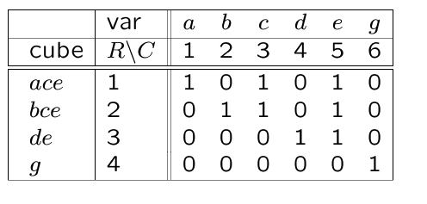
Matrix representation of kernels
f = ace + bce + de +g
Incidence matrix
  Cubes vs. variables
Rectangle
  Subset of rows/columns with all entries equal to 1
Prime rectangle
  Rectangle not included in another rectangle
A co-kernel is a prime rectangle with at least two rows
Example:
  Prime rectangle ({1,2},{3,5})
  Co-kernel ce

Slide 50
Application of kernel methods
Single cube extraction
  Extract one cube from two (or more) sub-expressions [Brayton]
Kernel extraction
  Extract a multiple-cube expression [Brayton]
Double-cube extraction
  Newer fast and efficient routine [Rajski]
Kernel-based decomposition

Slide 51
Single-cube extraction
Form an auxiliary expression, which is the union (sum) of all local expression
Find the largest co-kernel
  Corresponding kernel must belong to two (or more) different expressions
  Use additional variables to tag the expressions
Extract chosen co-kernel
The problem can be well visualized by a matrix representation and the extraction of a prime rectangle

Slide 52
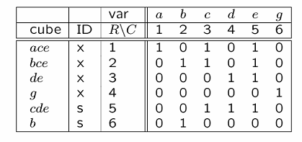
Example
Expressions:
  f_{x} = ace + bce + de + g
  f_{s} = cde + b
Auxiliary function:
  f_{aux} = ace + bce + de + g + cde + b
Tagging:
  f_{aux} = xace + xbce + xde + xg + scde + sb
Co-kernel: ce
After cube extraction
  f_{z} = ce
  f_{x} = z (a+b) + de + g
  f_{s} = ze + b

Slide 53
Multiple-cube extraction
We need a cube/kernel matrix
  Relabel cubes by new variables
  Kernels are now cubes in these new variables
Find a prime rectangle
Equivalently, find a co-kernel of the auxiliary expression that is the sum of the relabeled expressions

Slide 54
Example
f = ace + bce
  K(f) = {(a+b)}
g = ae + be + d
  K(g) = {(a+b); (ae +be+d)}
Relabeling: x_{a}=a; x_{b}=b; x_{ae}=ae; x_{be}=be; x_{d}=d
  Then K(f) ={{x_{a},x_{b}}} and K(g) = {{x_{a},x_{b}},{x_{ae},x_{be},x_{d}}}
  f_{aux} = f x_{a} x_{b} + g x_{a} x_{b} + g x_{ae} x_{be} x_{d}
  CoK(f_{aux}) = x_{a} x_{b}
Go back to original variables
  Extract (a + b) from f and g

Slide 55
Double-cube extraction
Restrict extraction to:
  Double-cube kernels
  Single-cube kernels with two literals
  Consider concurrently their complements
Properties
  These small kernels can be computed efficiently
  Circuit testability is preserved
  Method is very efficient in reducing network

Slide 56
Kernel-based decomposition
There are many different ways of performing decomposition
  Several classic approaches (e.g., Ashenhurst & Curtis)
Algebraic decomposition
  Find good algebraic divisors
  Use kernels and decompose recursively

Slide 57
Example
Decompose f = ace + bce + de + g
Select kernel ac + bc + d
Decompose as: f = te + g; t = ac + bc + d
Recur on quotient t
Select kernel a + b
Decompose t = sc + d; s = a + b; f = te + g;

Slide 58
Summary algebraic methods
Algebraic methods abstract functions as polynomials
  Polynomial division
Methods are fast and widely applicable
Algebraic methods miss opportunities for optimization
  As compared to Boolean methods
Algebraic transformations are reversible
  Ease transformations back and forward to trade off area and speed

